Slide 1

Franchise Opportunity for Barbeque Natation Restaurant in West Toronto

Slide 2
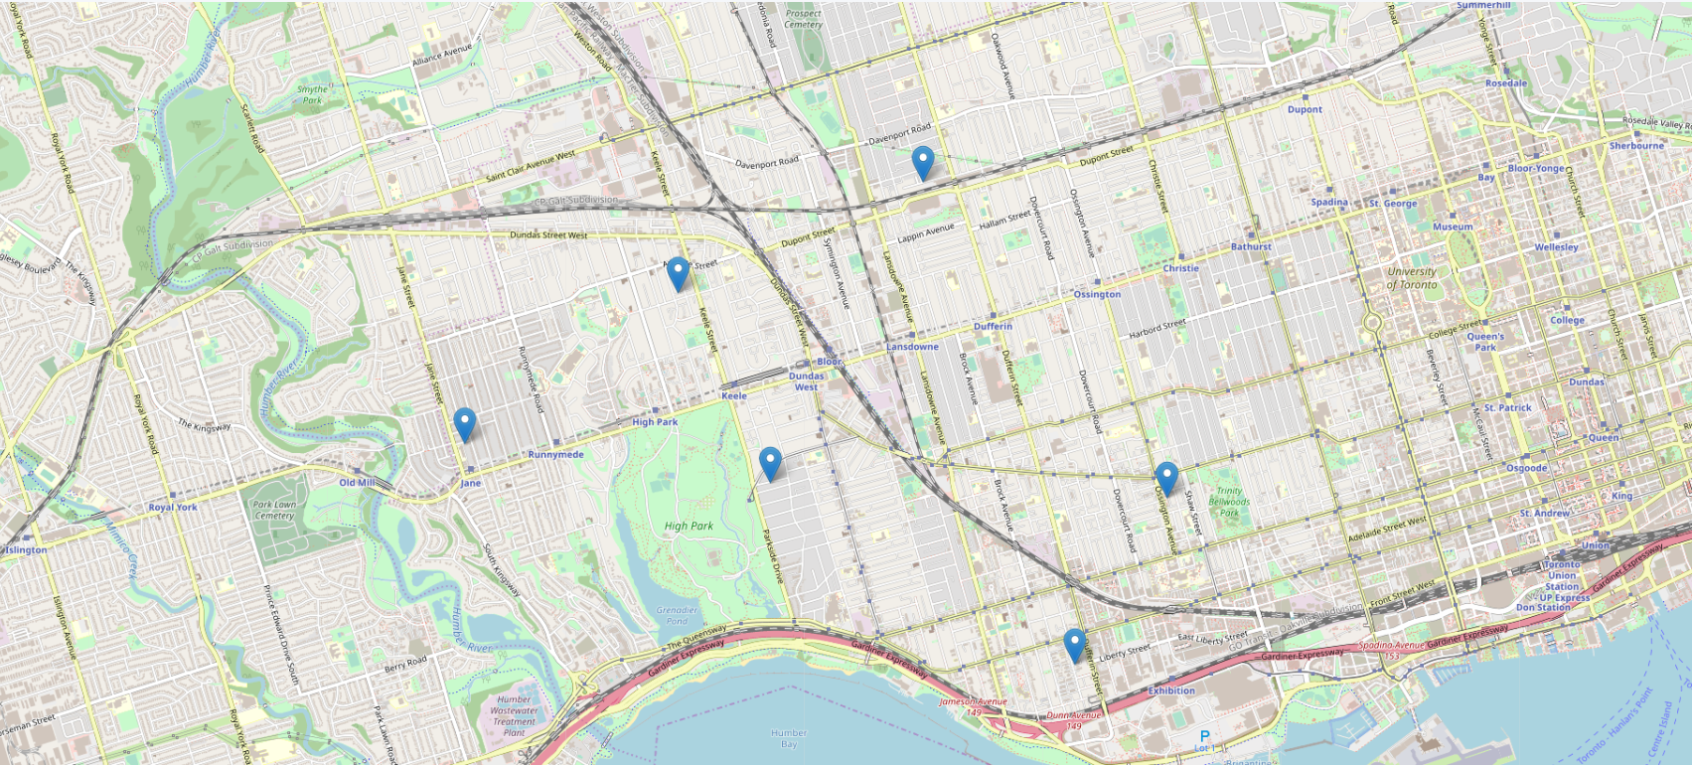
Introduction
Franchise Opportunity in Barbeque Nation
Recommended Location by Barbeque Nation is Western Toronto

Slide 3
West Toronto
6 Postal Codes
12 Neighbourhoods
99 Venus as per Foursquare

Slide 4
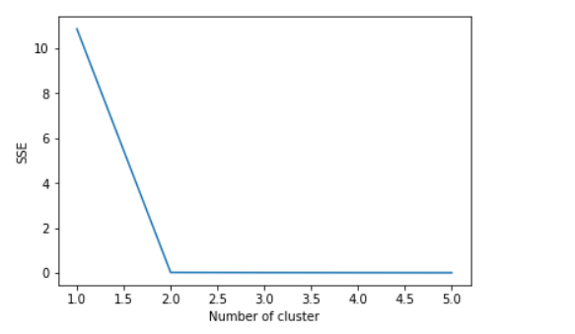
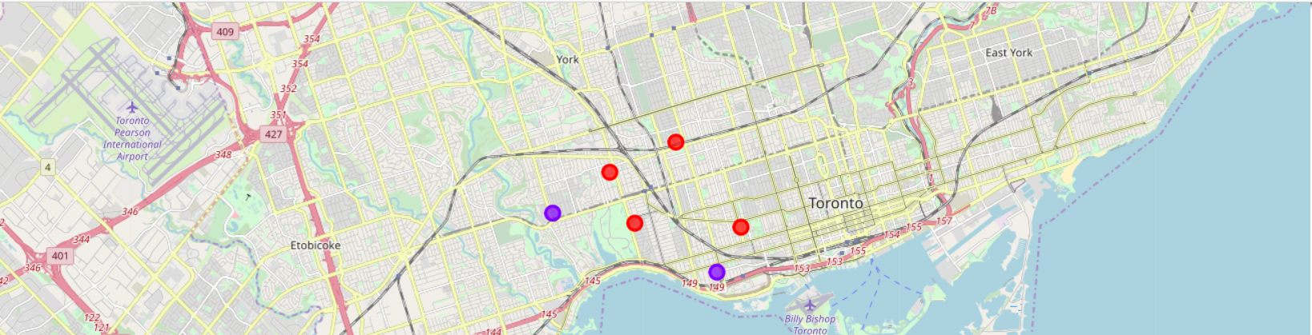
West Toronto – Clustering
Recommending Number of Clusters = 2
Cluster | Neighbourhood
1 | Dover court Village, Dufferin
1 | Little Portugal, Trinity
1 | High Park, The Junction South
1 | Parkdale, Roncesvalles
2 | Brockton, Exhibition Place, Parkdale Village
2 | Runnymede, Swansea

Slide 5
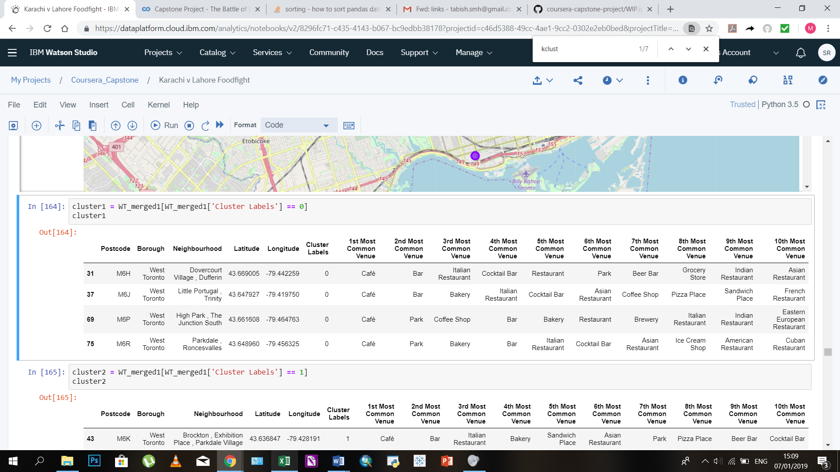
West Toronto Cluster 1 Most Common Venues

Slide 6
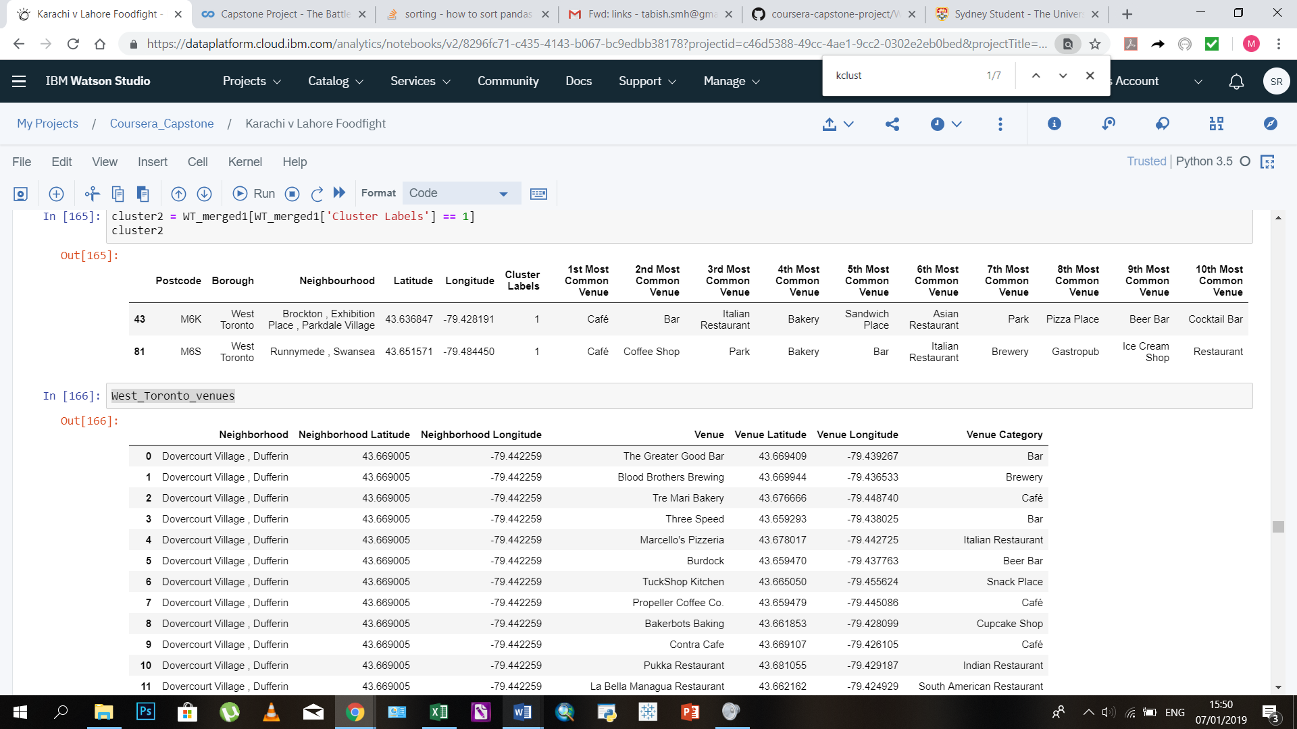
West Toronto Cluster 2 Most Common Venues

Slide 7
Number of Venues by Category Cluster 1
Category | Dovercourt Village, Dufferin | Little Portugal, Trinity | High Park, The Junction South | Parkdale, Roncesvalles
Cafe | 10 | 10 | 11 | 8
Bar | 8 | 6 | 6 | 6
Italian Restaurant | 4 | 5 | - | 4
Cocktail Bar | 4 | - | - | -
Park | 4 |  | 6 | 7
Bakery | - | 5 | 5 | 6
Asian Restaurant | - | 4 | - | -
Coffee shop | - | - | 6 | -

Slide 8
Number of Venues by Category Cluster 2
Category | Brockton, Exhibition Place, Parkdale Village | Runnymede, Swansea
Cafe | 7 | 8
Bar | 6 | 5
Italian Restaurant | 5 | -
Park | 4 | 6
Bakery | 5 | 5
Coffee shop | - | 8

Slide 9
Conclusion
Market Gap: Opportunity to be first movers in fine dining category
Competition from fast food restaurants
Recommended Location in Cluster 1
Limitation:
Foursquare data
Recommendation does not take financial aspects into consideration

